Slide 1
Online Quiz Application
CAPSTONE PROJECT
Presented By:
Name : B Surya Teja
College Name : Presidency University
Department : Computer Science Engineering

Slide 2
OUTLINE
Problem Statement
System Development Approach
Algorithm & Deployment
Result
Conclusion
Future Scope
References

Slide 3
Problem Statement
Traditional quiz applications often lack flexibility, personalization, and offline accessibility. Most systems rely only on fixed question sets without supporting custom question management. Users face limited control over quiz settings like timer, difficulty, or infinite mode. Admins usually struggle to manage large question banks efficiently in a lightweight system. There is also a need for history tracking and performance analysis for learners. Hence, a smart, user-friendly, browser-based quiz system is required to overcome these limitations.

Slide 4
System Approach
Frontend Technologies
HTML5: For semantic page structure and panels.
CSS3 / Flexbox / Grid: For responsive layout, modern styling, gradient backgrounds, animations, and custom components.
JavaScript (ES6): Core logic for:
Authentication
Quiz management and timer
Local Storage persistence
Admin panel CRUD operations
Dynamic DOM manipulation and event handling
Fonts: Google Fonts-Poppins.
External API: Open Trivia DB (fetch fallback questions).

Slide 5
System Approach
Design Approach
User-Centered Design:
Clear separation of login/signup, quiz setup, quiz panel, and results.
Immediate feedback using overlay messages for correct/wrong answers.
Sidebar shows live score, progress, and quick actions for easy access.
Responsive & Interactive Layout:
CSS Grid and Flexbox for main layout and sidebar.
Hover and click animations for buttons and quiz choices.
Timer bar with dynamic width animation.
Colour & Theme:
Dark theme with gradient accents.
Success/Failure colours for quiz feedback.
Consistent visual hierarchy for readability and user experience.
SPA Behaviour:
Panels shown/hidden dynamically without page reloads.
Smooth quiz progression with randomized question order and infinite mode support.

Slide 6
Algorithm & Deployment
Product Catalog Creation
Define the quiz structure (qualification, subject, course, and language).
Store questions in a structured format within local Storage as a catalog.
Provide admin access to add, edit, and delete questions dynamically.
Frontend Design
Use HTML5, CSS3 (Grid/Flexbox), and Google Fonts for responsive layout.
Implement dark-themed UI with gradient accents for better engagement.
Organize panels for login, quiz setup, quiz runtime, and admin management.
Interactive Features
Enable timers, progress tracking, overlays for correct/wrong answers.
Support infinite quizzes, customizable settings, and performance history.
Add admin tools for CRUD operations on question banks with live preview.
Testing
Perform unit testing on quiz logic (timers, scoring, randomization).
Conduct UI/UX testing for responsiveness across devices.
Validate local Storage persistence and Open Trivia DB integration.

Slide 7
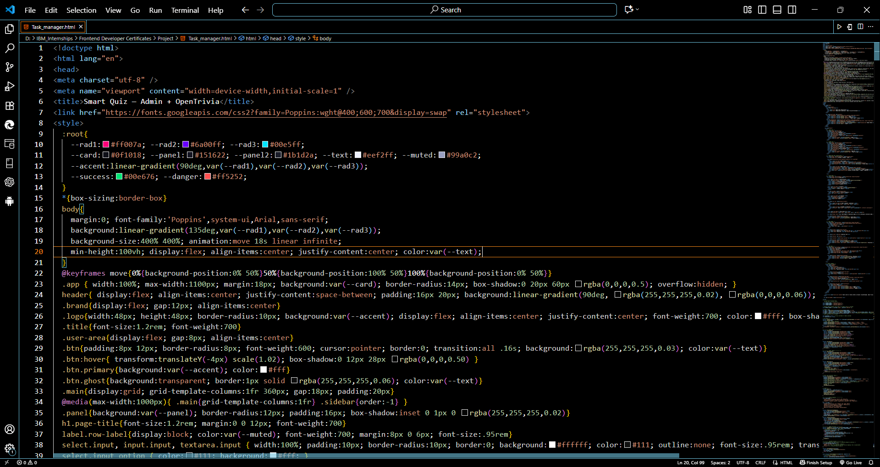
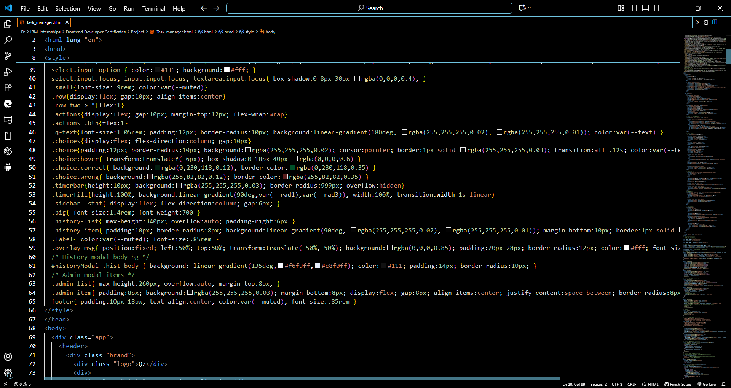
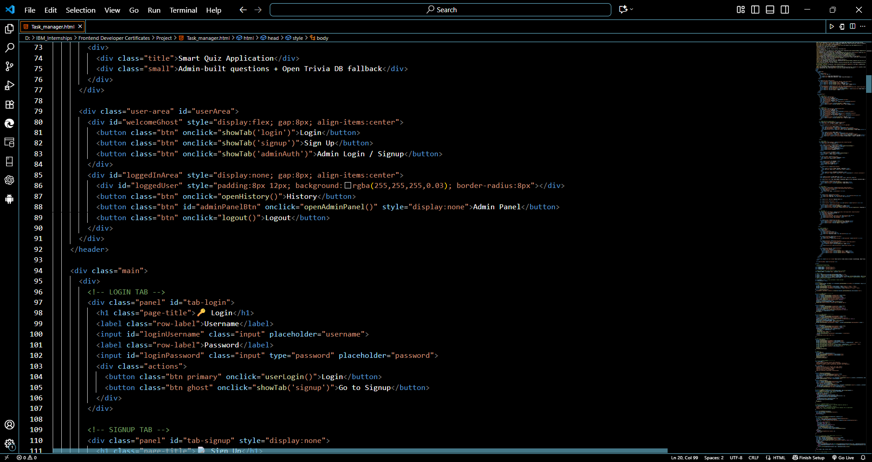
Project Code

Slide 8
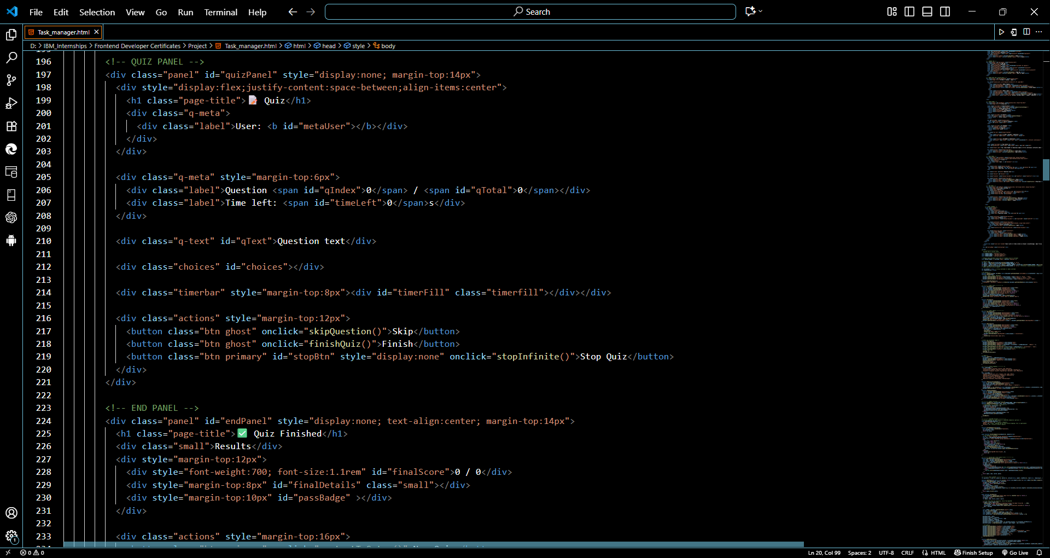
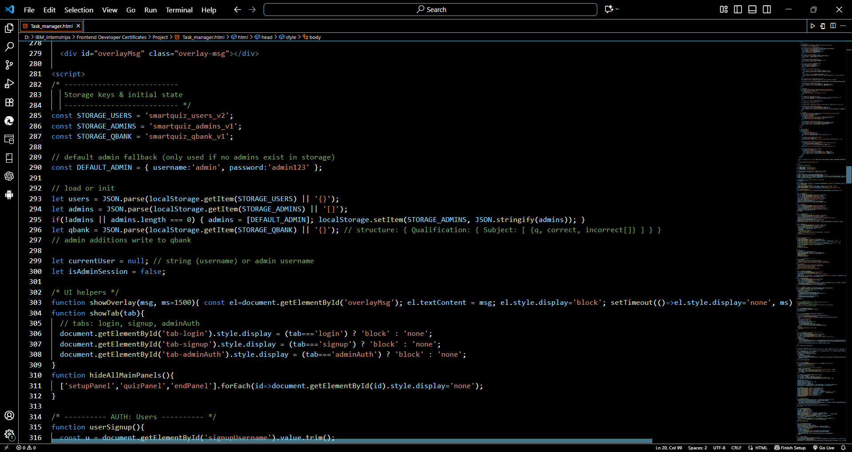
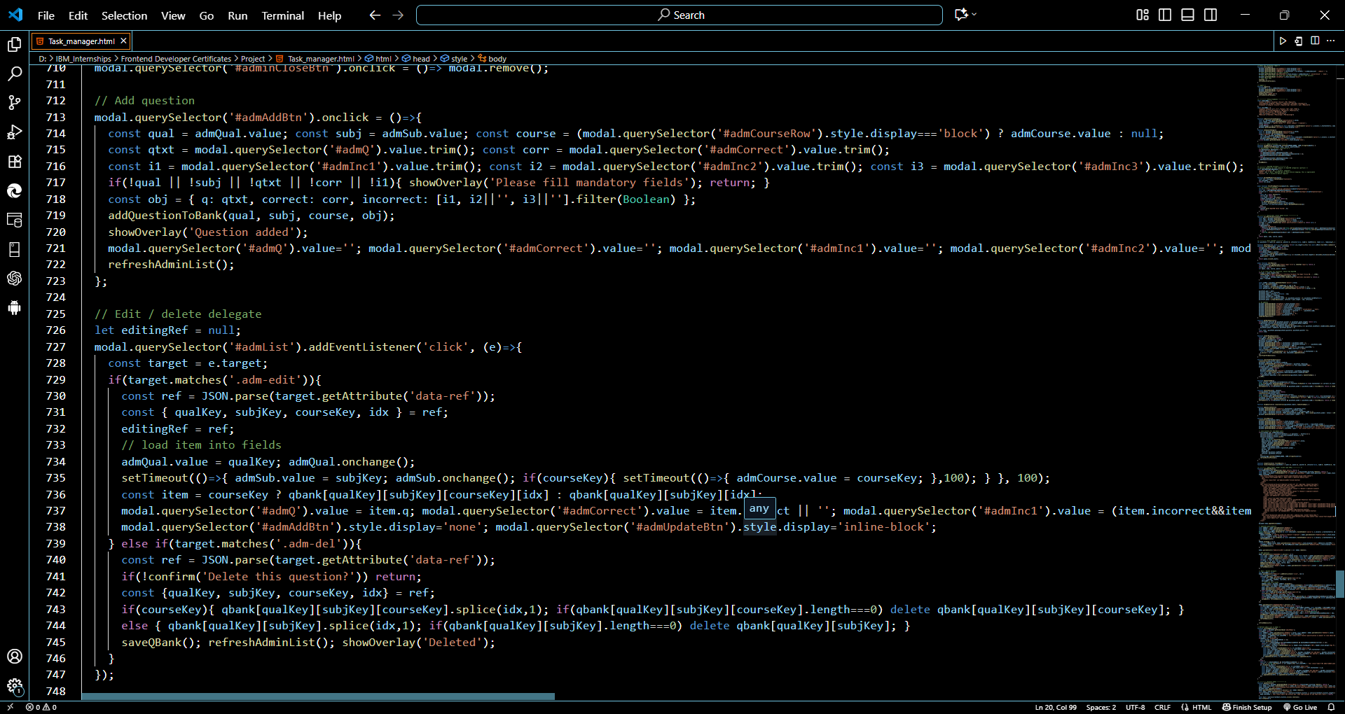
Project Code

Slide 9
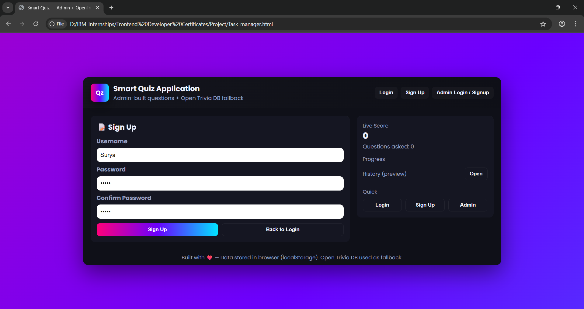
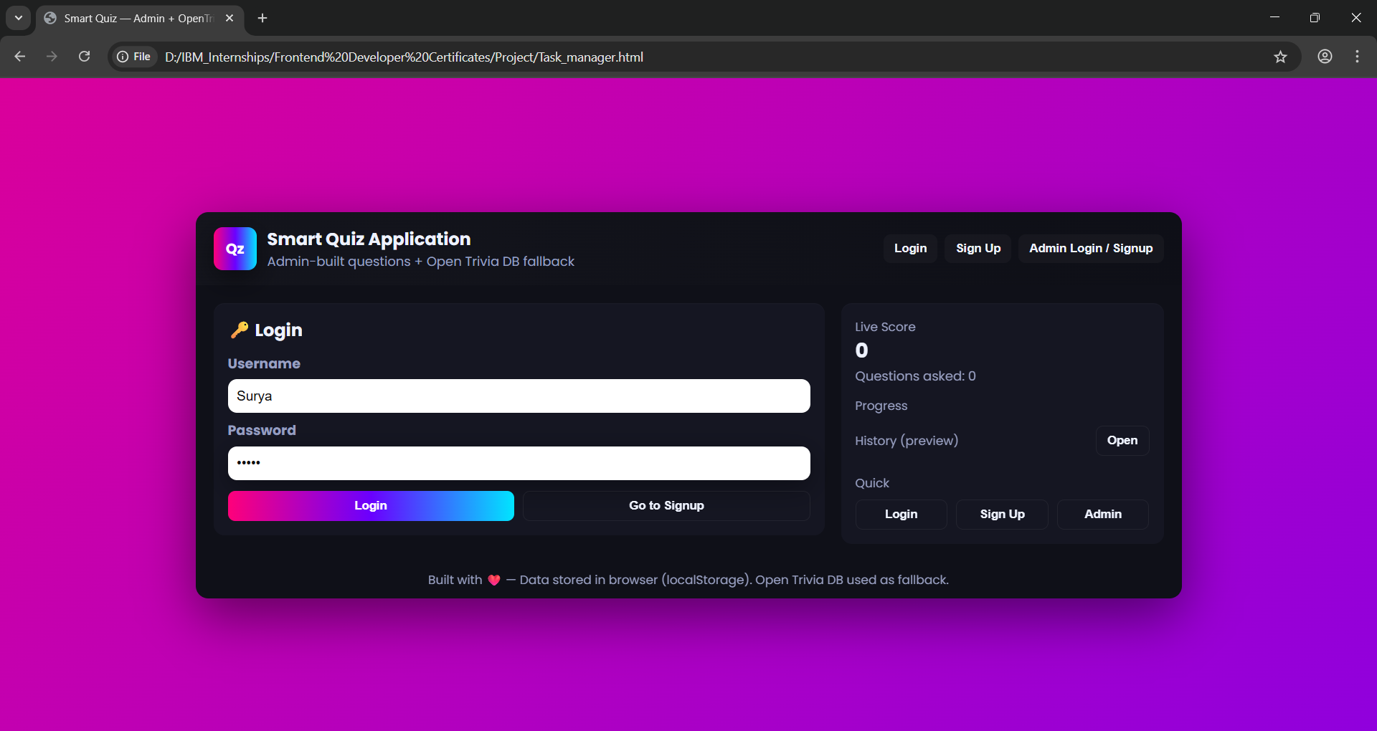
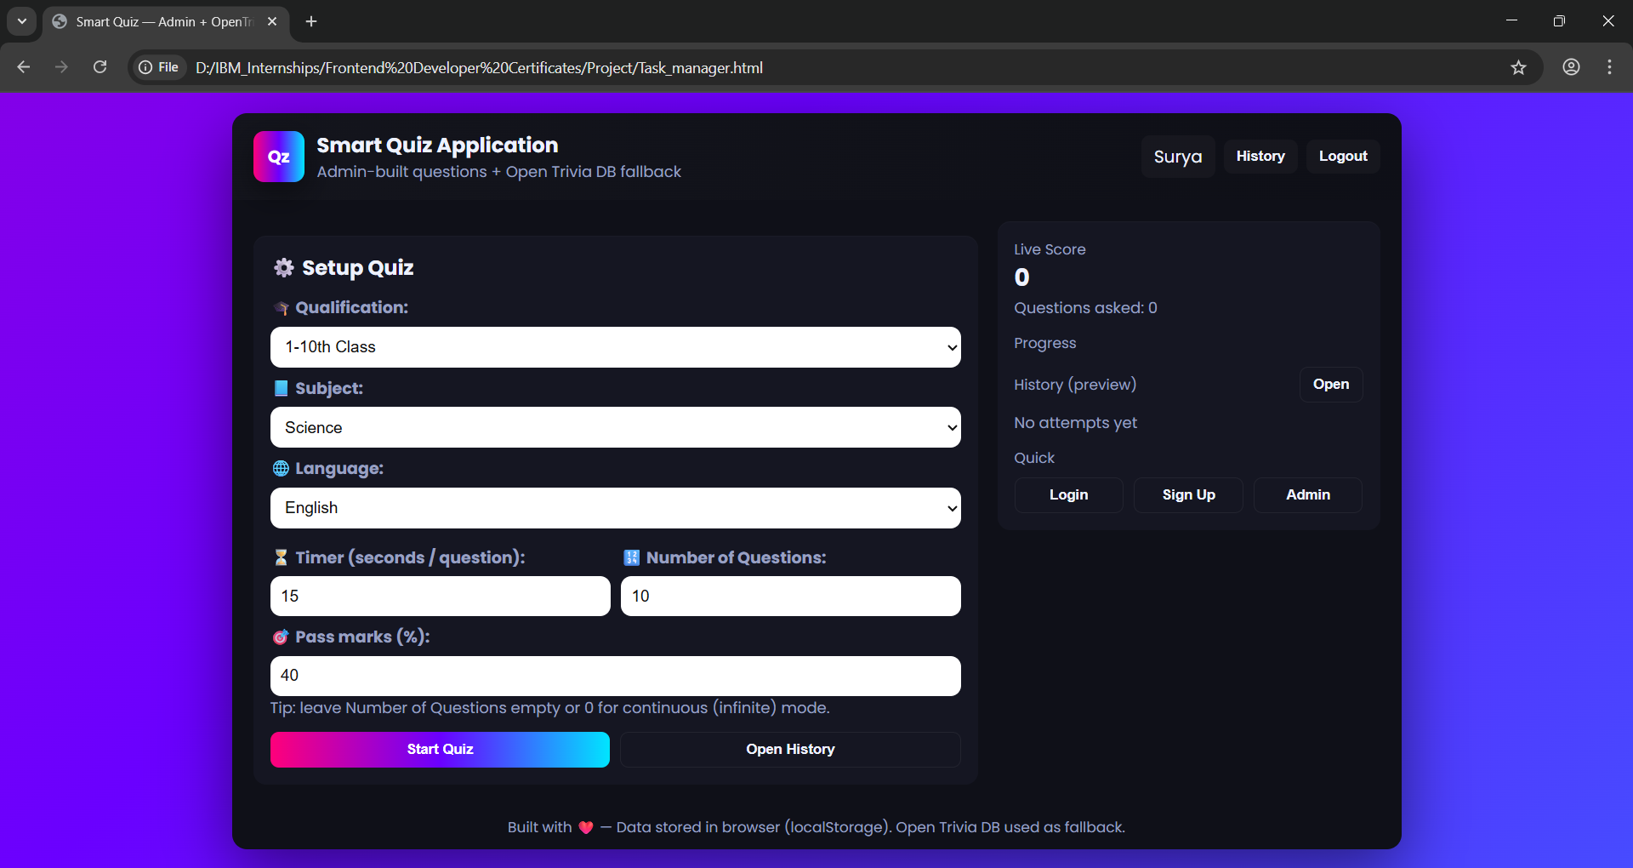
Result

Slide 10
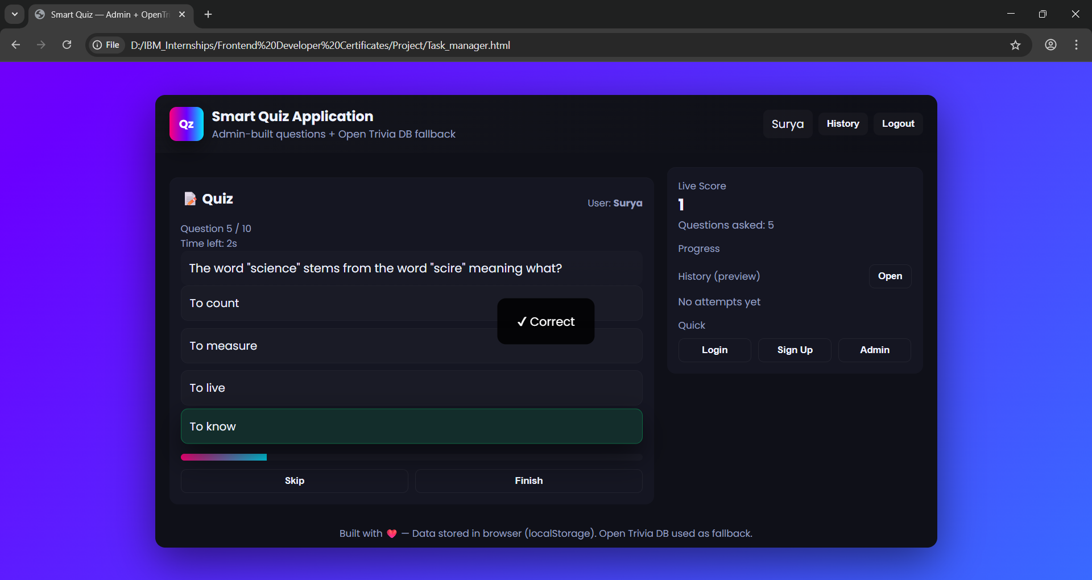
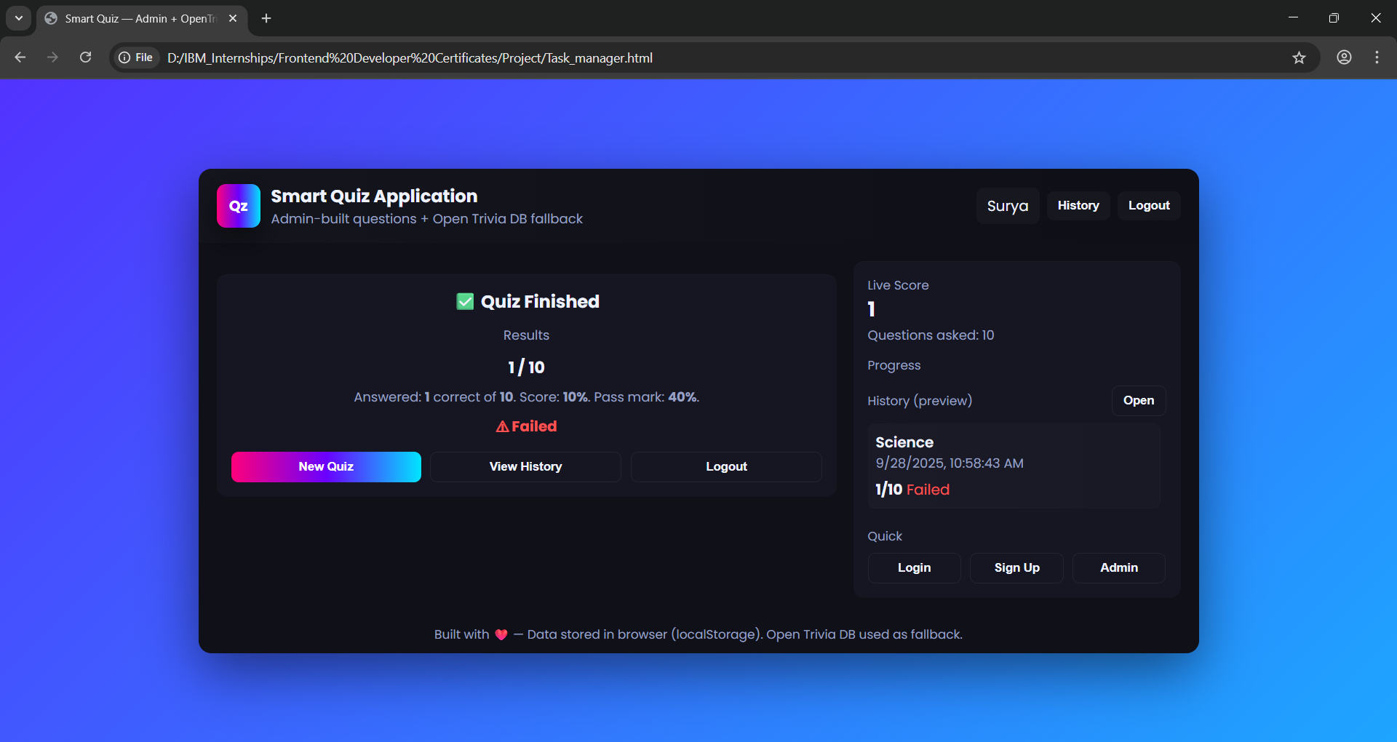
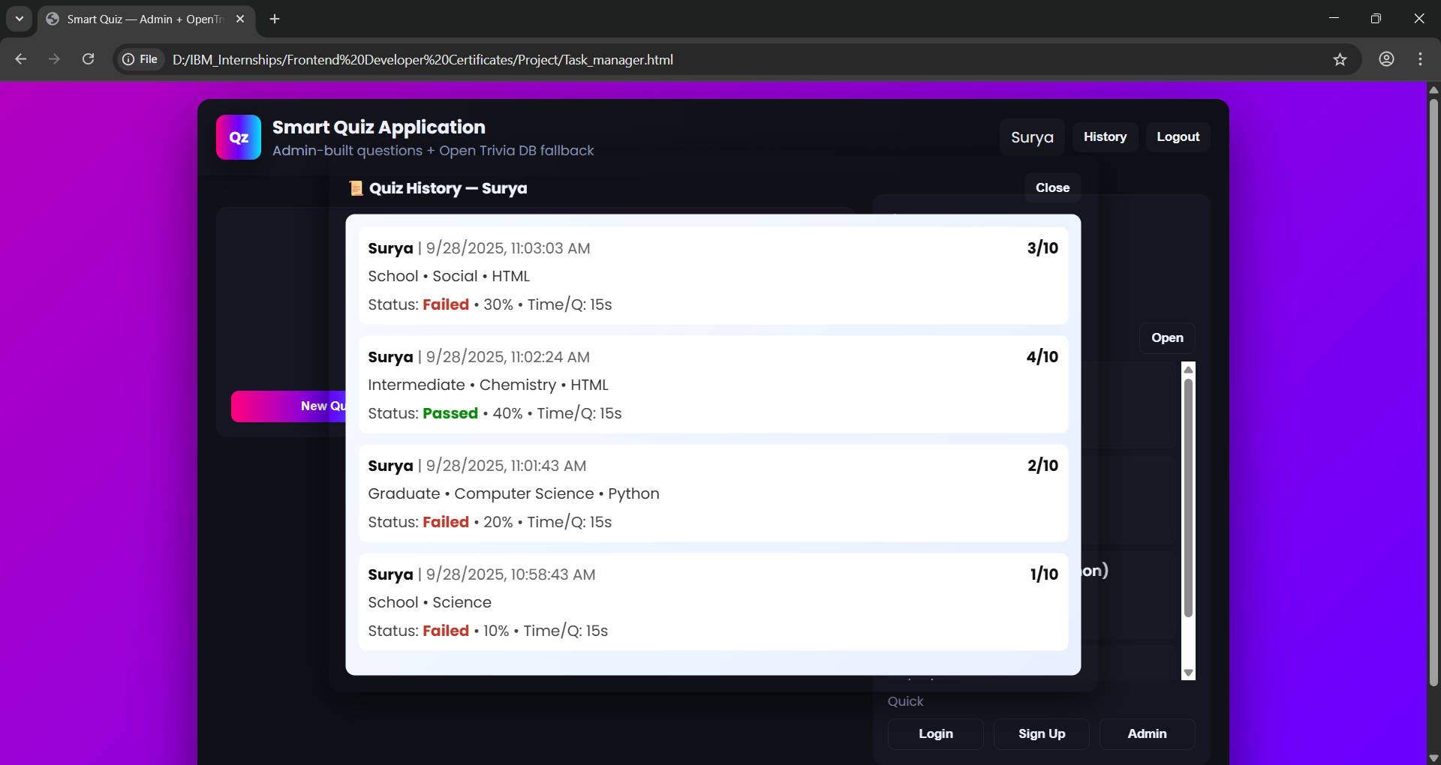
Result

Slide 11
GITHUB AND DEPLOYMNET LINK
Attach your Github Link : https://github.com/SuryaTeja122/Online-Quiz-Application-Internship-Project.git
Deployment link: https://suryateja122.github.io/Online-Quiz-Application-Internship-Project/

Slide 12
Conclusion
The Online Quiz Application demonstrates an effective integration of frontend technologies and interactive design to provide a seamless user experience. Through systematic development from product catalog creation, frontend design, to interactive feature implementation the system ensures accuracy, usability, and engagement for users. Testing and deployment further validate the application’s reliability and performance. Overall, this project highlights the importance of structured development approaches and modern technologies in creating practical, user-friendly educational tools.

Slide 13
Future scope(Optional)
Mobile Application Development: The quiz system can be extended to mobile platforms (Android/iOS) to enhance accessibility.
AI-Based Question Generation: Implement AI algorithms to automatically generate and categorize questions based on difficulty levels.
Analytics and Reporting: Integrate advanced analytics to track user performance, strengths, and weaknesses for personalized learning.
Gamification Features: Add leaderboards, badges, and rewards to increase user engagement and motivation.
Multilingual Support: Expand the application to support multiple languages for a wider audience.
Integration with Learning Platforms: Connect with e-learning portals or educational institutes for seamless content management.

Slide 14
References
https://seldomindia.com/building-a-simple-quiz-app-with-html-css-and-javascript/
https://www.scribd.com/document/579414230/Mini-Project-Report-quiz
https://dev.to/linusmwiti21/level-up-your-skills-build-a-web-quiz-app-with-basic-js-html-css-lm5
https://ijarsct.co.in/Paper24623.pdf

Slide 15
THANK YOU

